Slide 1
EQD Research Global Insights
Futures Radio Show Graphics

Slide 2
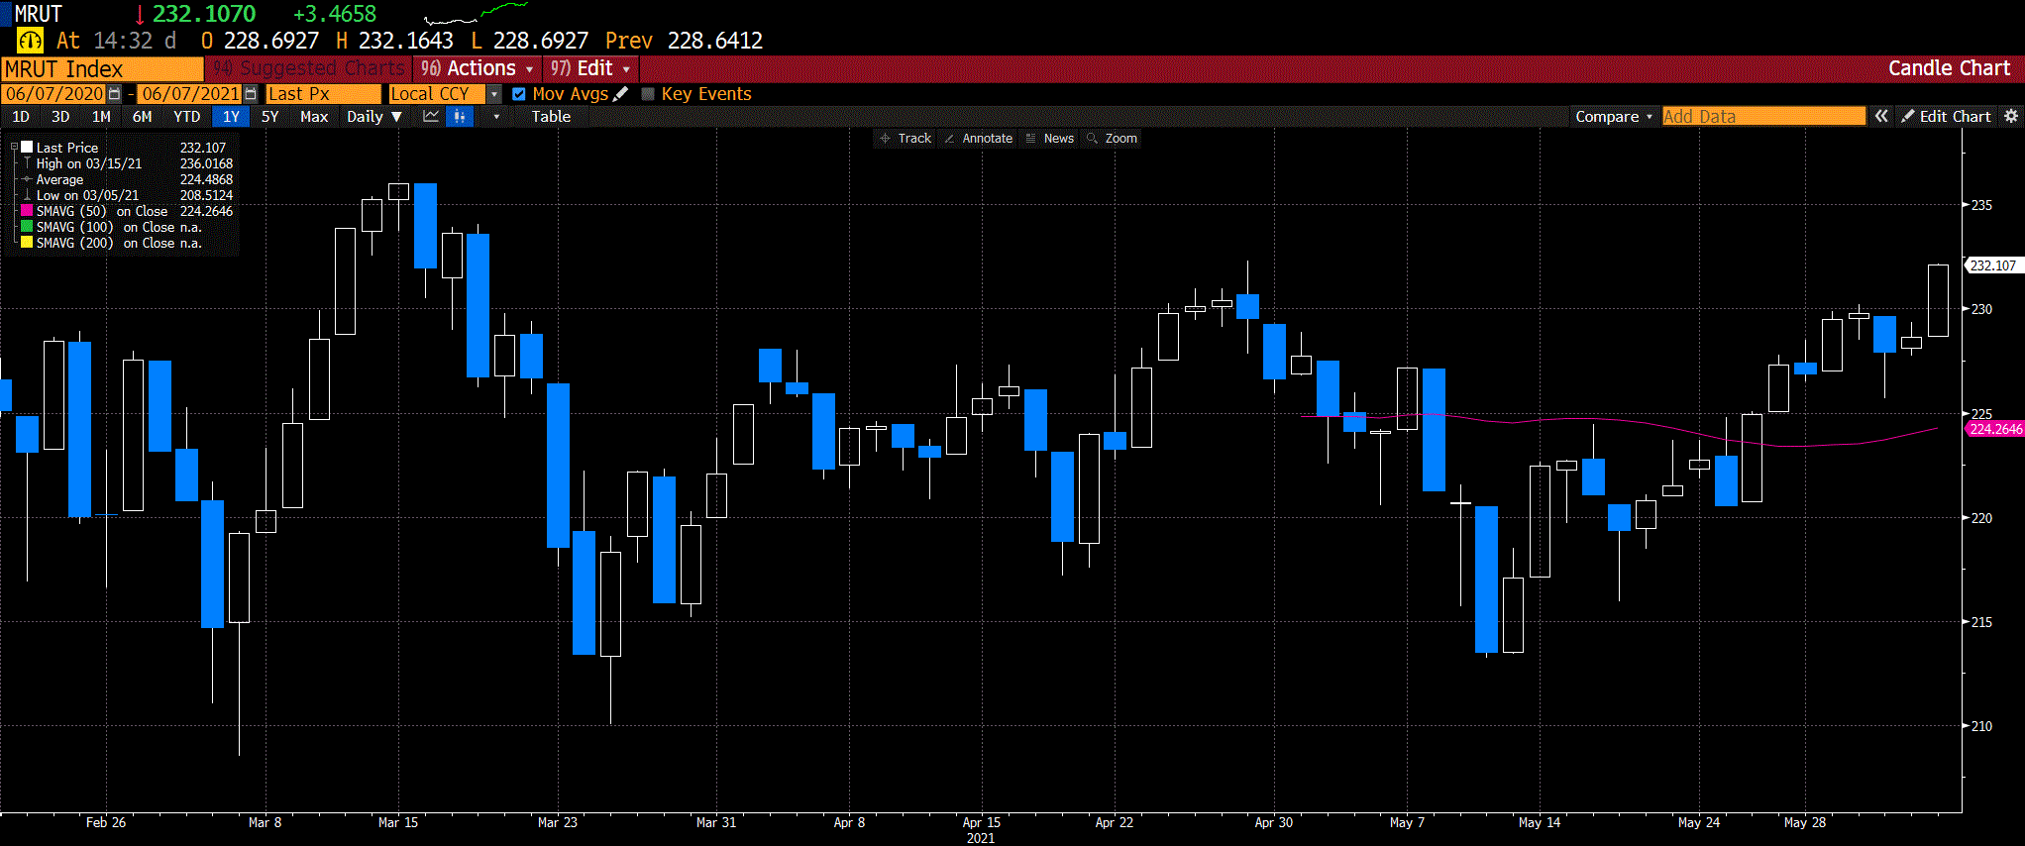

Slide 3
June 7th
MRUT @ 232.10
Sell Jun 9th 230 Call @ 2.30
Buy Jun 9th 235 Call @ 0.10
Net Credit = 2.20
Risk = 2.80

